Slide 1
P589-1 Refined hashtag processing initial clustering
20240710

Slide 2
Features/cell are high

Slide 3
Mitochondrial reads are low

Slide 4
Samples with higher mito counts are lower in genes

Slide 6
Hashtag expression cutoffs

Slide 8
Clustering by ht

Slide 9
Clustering by ht, multiplets/negatives removed

Slide 10
Rna-based umap clusters

Slide 11
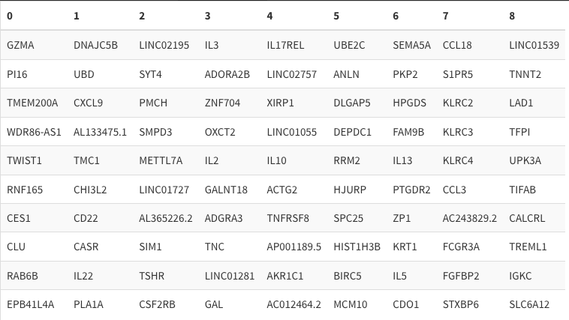

Slide 12
Hashtags do not cleanly separate by rna clustering

